Slide 1
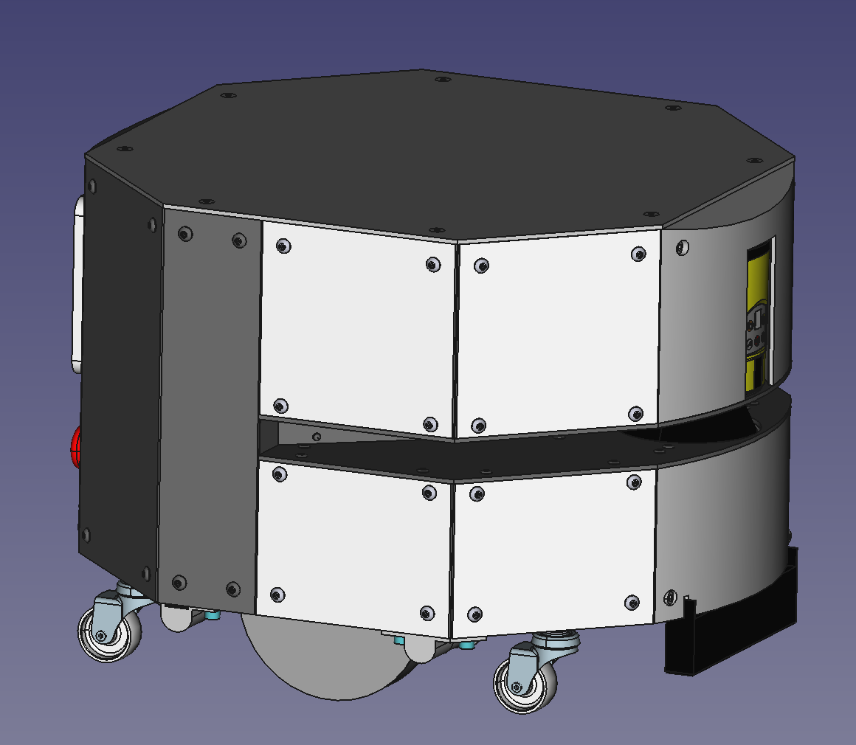
AMR
Parts manufacturing

Slide 2
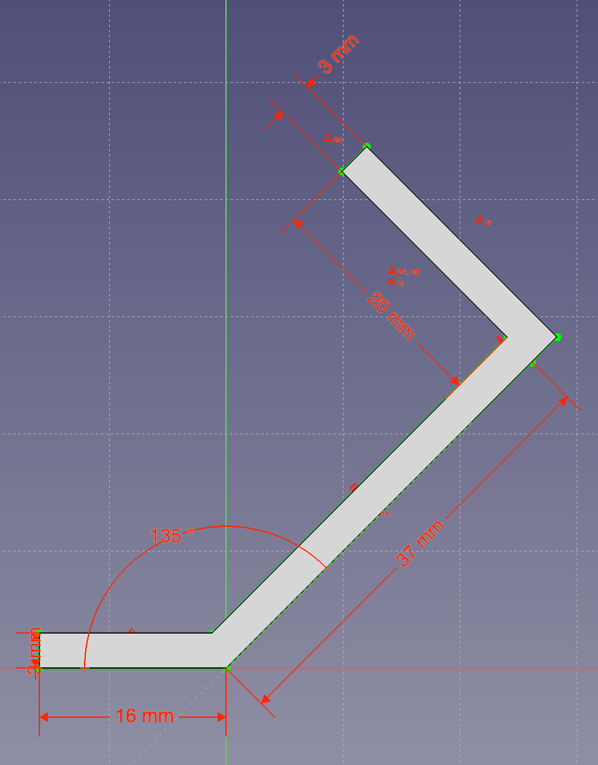
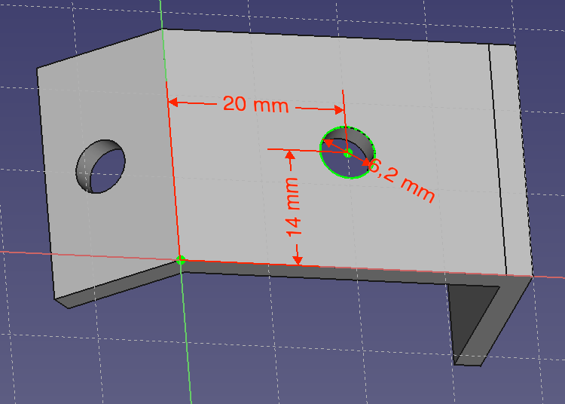
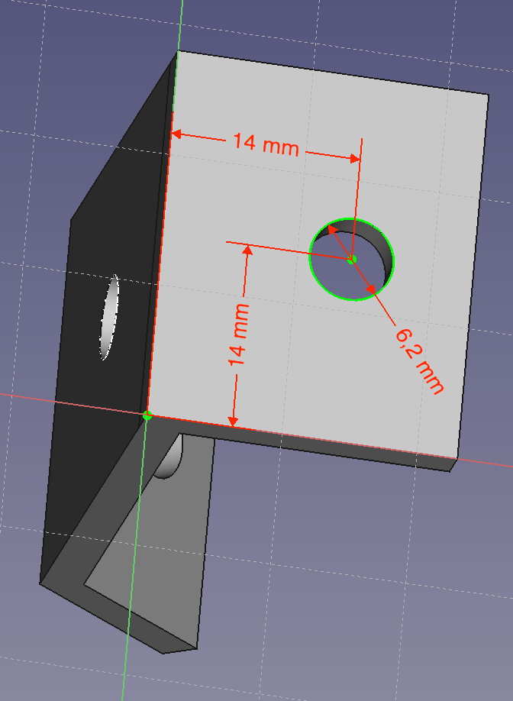
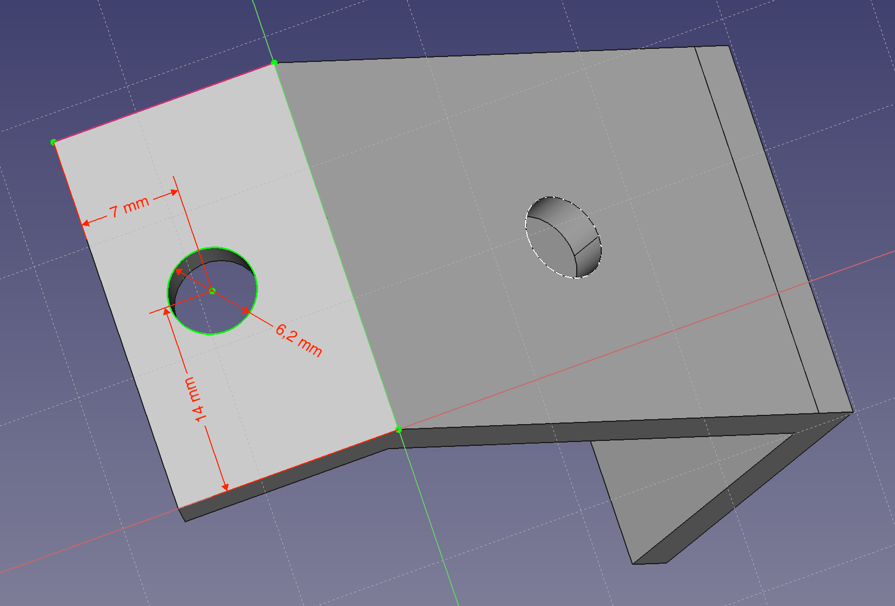
P0015 | 135deg_small_braket M6 3holes
Units: 4 + 4
Assembly: Chassis Top, Chassis Bottom
Source model: “Aluminum 30mm x 3mm flat bar” / 135degree_small_braket v2.FCStd

Slide 3
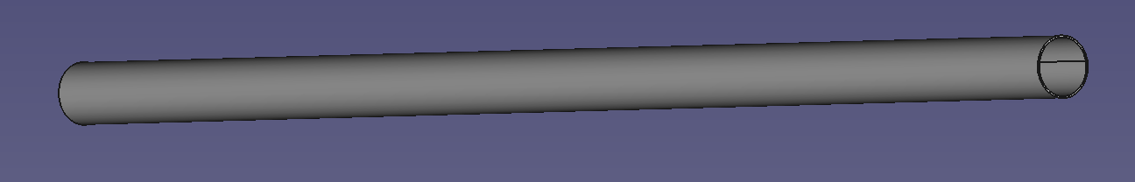
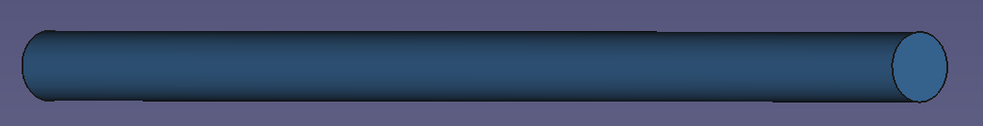
P0430 | Clutch axel (tube 410x16mm)
Length: 210mm, diameter: 16mm, wall: 0,5mm
Cut angle: 90deg both sides
Units: 1
Assembly: Clutch set
P0435 | Balancing axel (tube 390x16mm)
Length: 210mm, diameter: 16mm, wall: 0,5mm
Cut angle: 90deg both sides
Units: 1
Assembly: Balancing axel set
P0390 | Clutch lever (100x5mm bar)
Length: 100mm, diameter: 5mm
Cut angle: 90deg both sides
Units: 1
Assembly: Clutch set

Slide 4
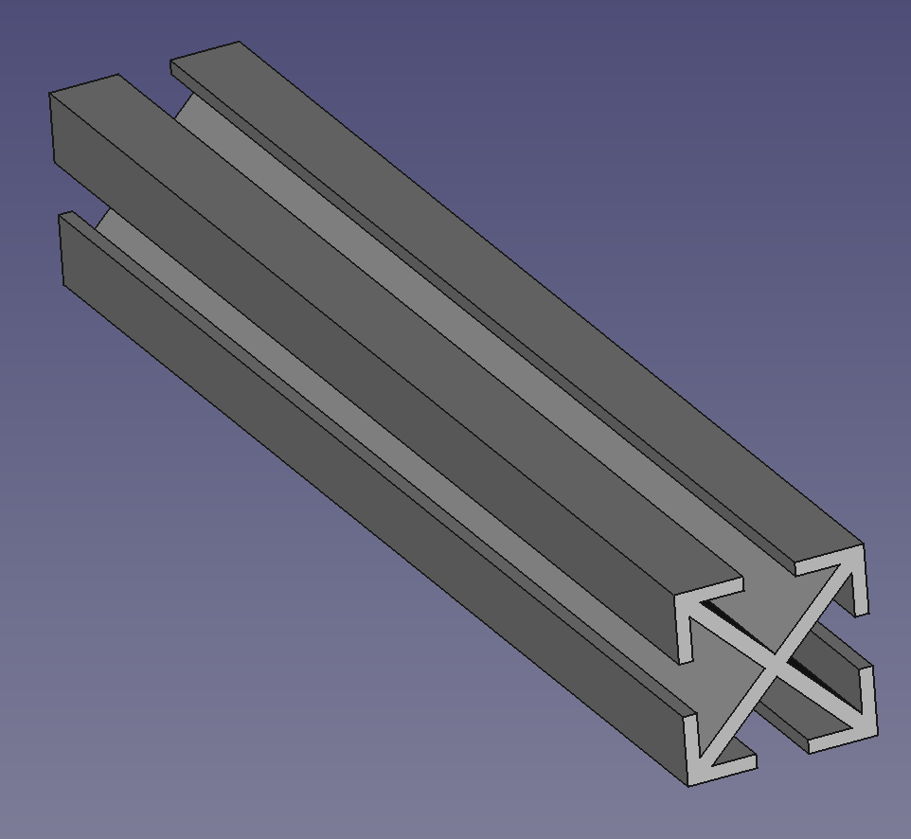
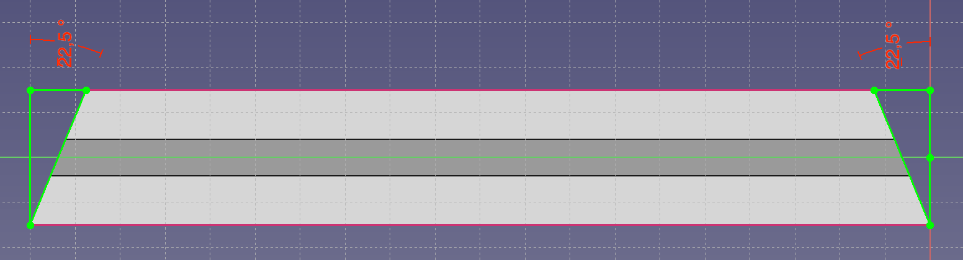
P0155 | 30x30 339 mm profile flat cut
Units: 2 + 2
Assembly: Chassis Top, Chassis Bottom
P0170 | 30x30_200mm profile flat cut
Units: 4
Assembly: Chassis Middle
P0175 | 30x30_60mm profile flat cut
Units: 2
Assembly: Set limit motors Top
Length long side: 204mm
Cut angle: 22,5deg both sides
Units: 4 + 4
Assembly: Chassis Top, Chassis Bottom
P0160 | 30x30 204mm profile 22,5deg cut
Length long side: 138mm
Cut angle: 22,5deg both sides
Units: 4 + 4
Assembly: Chassis Top, Chassis Bottom
P0165 | 30x30 138mm profile 22,5deg cut
NOTE: In the 4 units for “Chassis Bottom” make an 8,2mm hole in the middle for caster wheels
Source model for all: “30x30 profile” / 30x30 profiles.FCStd

Slide 5
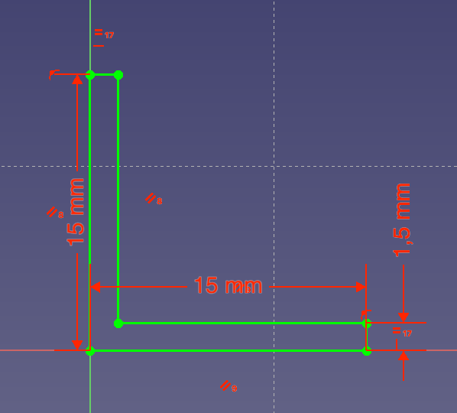
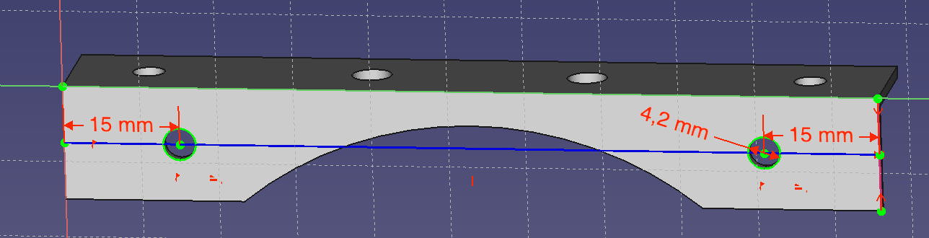
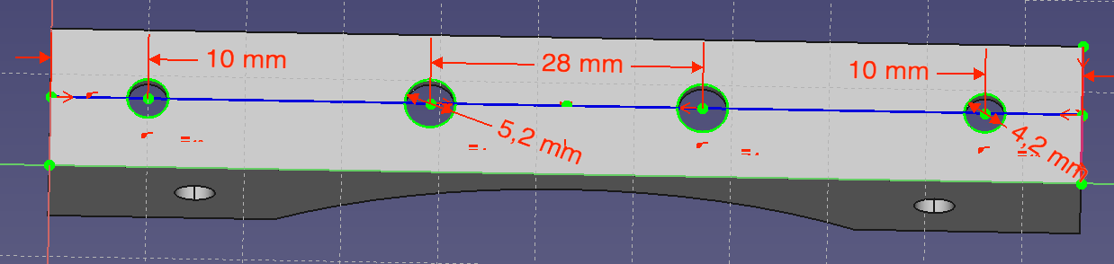
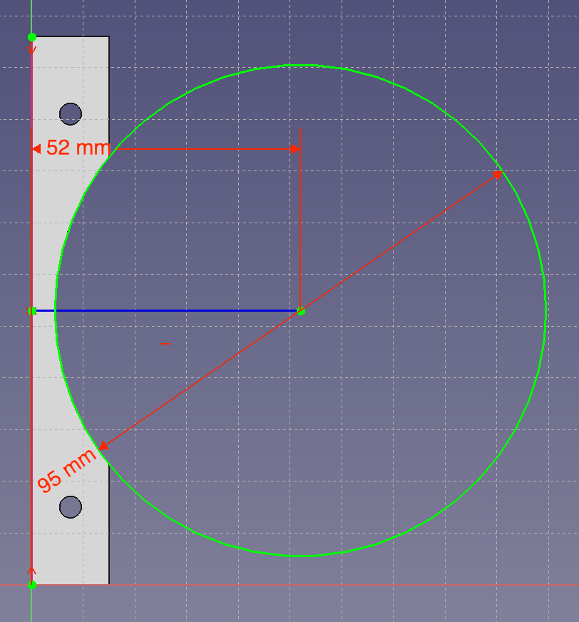
P0185 | Alu Profile L shape 15x15x1,5 106mm
Length long side: 206mm
Cut angle: 90deg
Units: 1+1
Assembly: Laser beam area – Bottom, Laser beam area – Top
Source Model: “Aluminum Profile L shape type 004” / Aluminum Profiles.FCStd

Slide 6
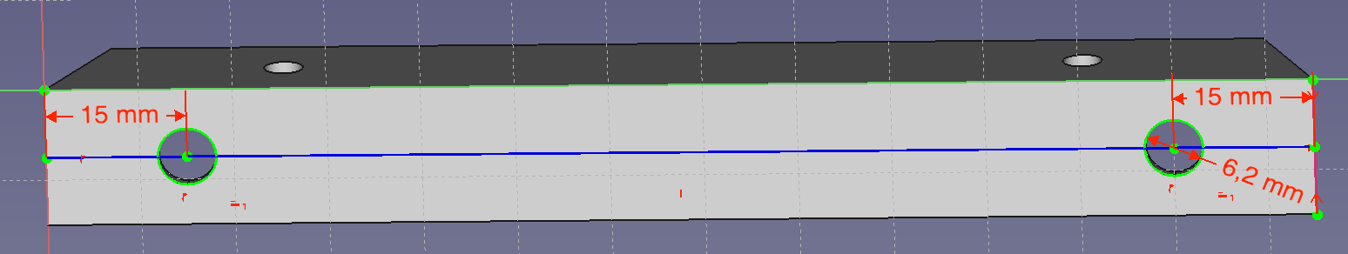
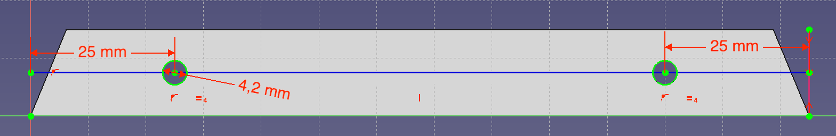
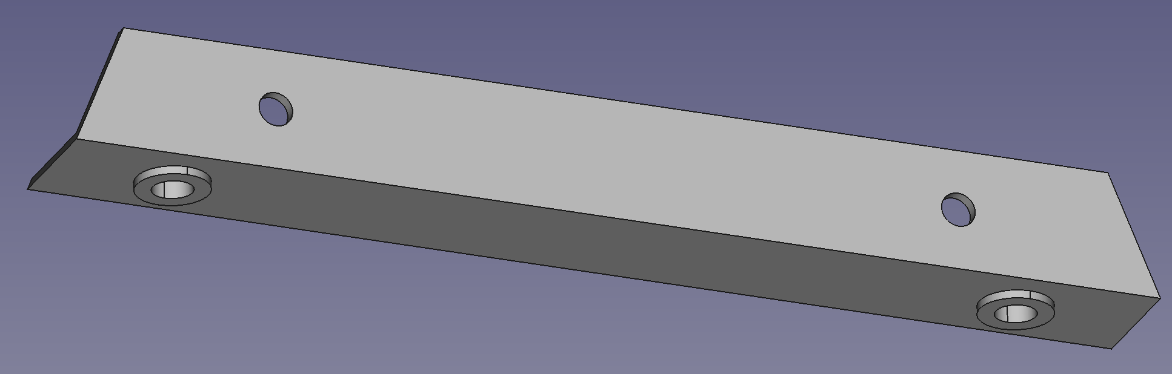
NOTE: Install M5 threaded rivet as shown
P0190 | Alu Profile L shape 15x15x1,5 135mm 22,5 deg
Length long side: 135mm
Cut angle: 22,5deg both sides
Units: 2 + 2
Assembly: Laser beam area – Bottom, Laser beam area – Top
P0195 | Alu Profile L shape 15x15x1,5 137,5mm 22,5deg
Length long side: 137,5mm
Cut angle: 22,5deg both sides
Units: 2 + 2
Assembly: Laser beam area – Bottom, Laser beam area – Top
Source Model for all: “Aluminum Profile L shape type 002” / Aluminum Profiles.FCStd

Slide 7
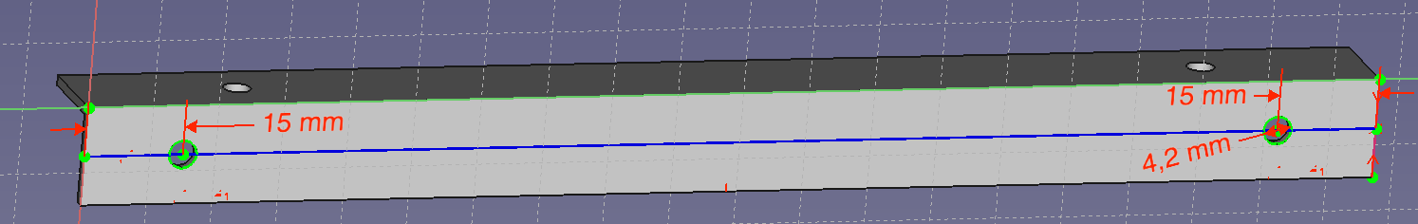
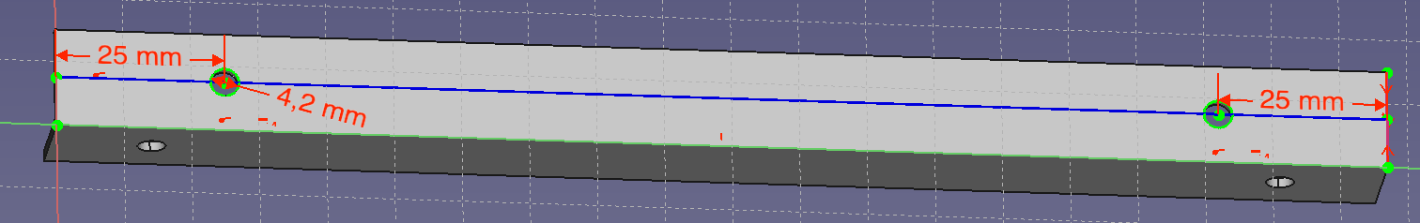
P0200 | Alu Profile L shape 15x15x1,5 197mm
Length long side: 197mm
Cut angle: 90deg both sides
Units: 2
Assembly: Laser beam area – Top
Source Model: “Aluminum Profile L shape type 003” / Aluminum Profiles.FCStd

Slide 8
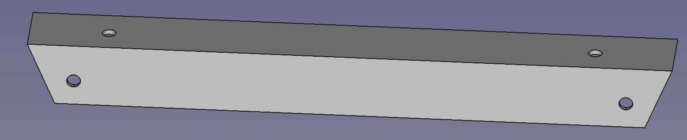
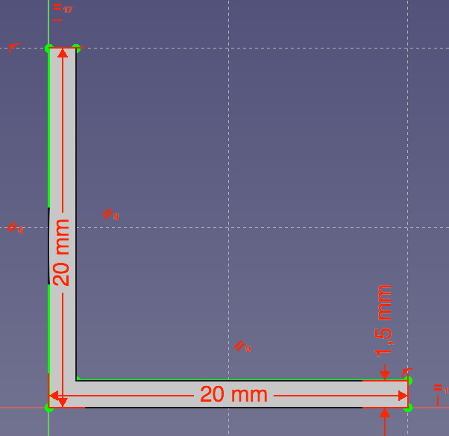
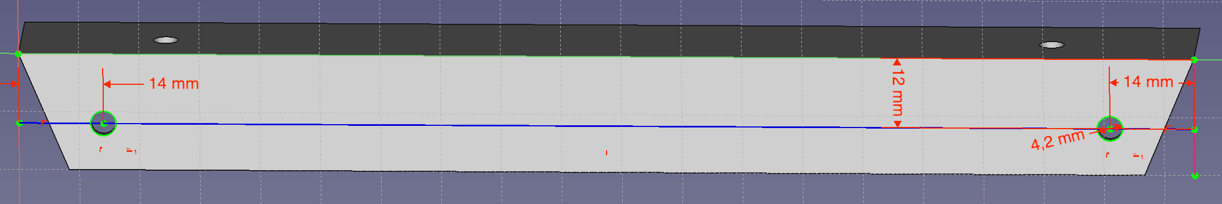
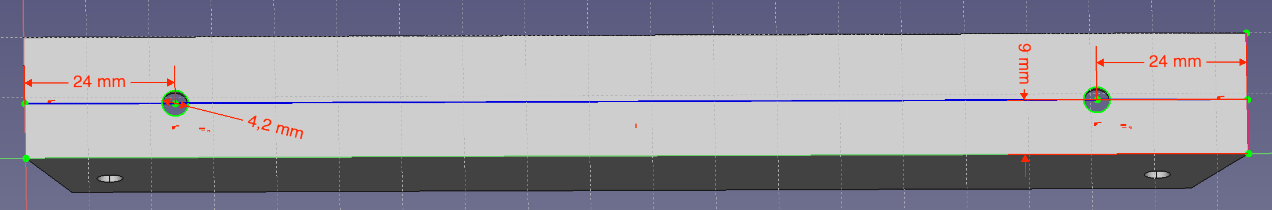
P0205 | Aluminum Profile L shape 20x20x1,5 195mm 22,5 deg
Length long side: 195mm
Cut angle: 22,5deg both sides
Units: 2
Assembly: Laser beam area – Bottom
Source Model: “Aluminum Profile L shape type 005” / Aluminum Profiles.FCStd

Slide 9
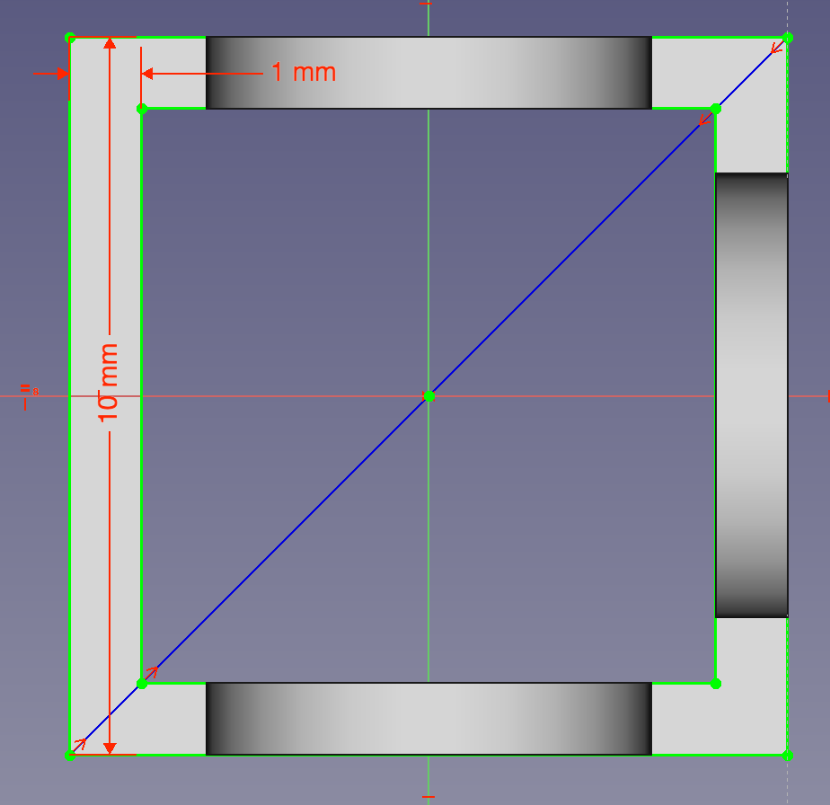
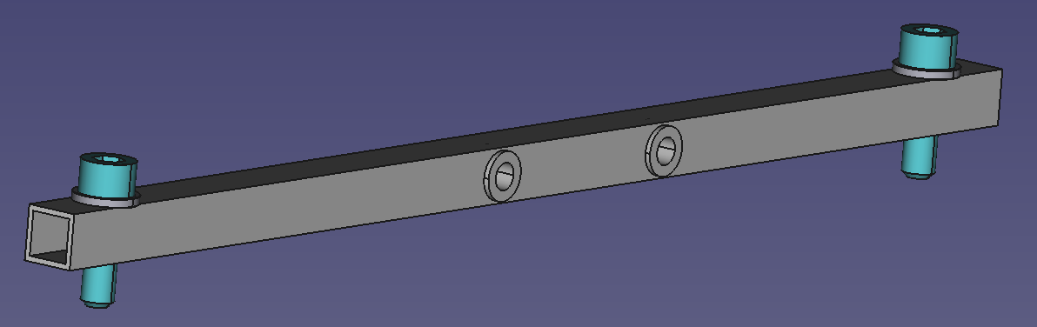
P0215 | Alu Profile square 10x10x1 259mm with holes
NOTE: Install M5 threaded rivet as shown
Length long side: 259mm
Cut angle: 90deg both sides
Units: 2
Assembly: Chassis Middle
Source Model: “Z_Alu Profile square 10x10x1 with holes” / Aluminum Profiles.FCStd

Slide 10
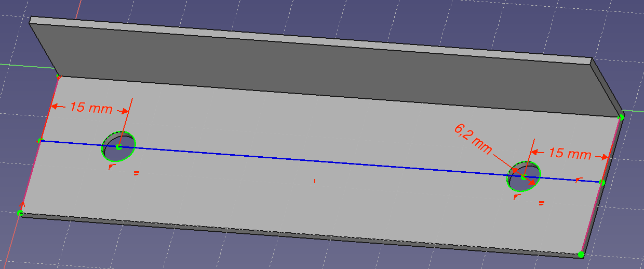
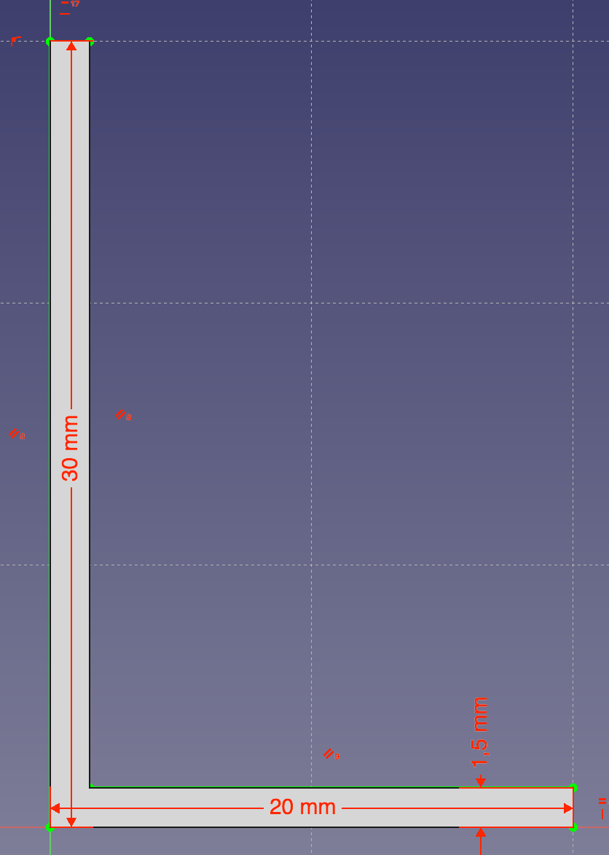
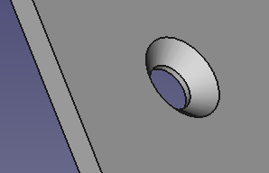
P0220 | Aluminum Profile L shape 30x20x1,5 250mm
Length long side: 250mm
Cut angle: 90deg both sides
Units: 2
Assembly: Batteries support
P0230 | Aluminum Profile L shape 30x20x1,5 98mm
Length long side: 98mm
Cut angle: 90deg both sides
Units: 2
Assembly: Batteries support
Source Model for all: “Aluminum Profile L shape type 001” / Aluminum Profiles.FCStd

Slide 11
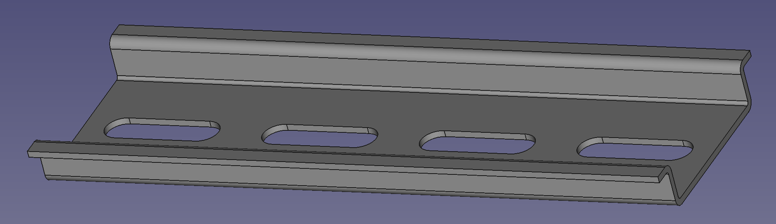
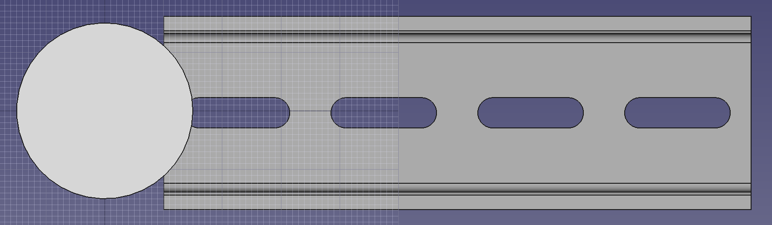
P0445 | DIN Rail 260mm
Length: 260mm
Cut angle: 90deg both sides
Units: 1
Assembly: Flexisoft set
NOTE: AGV_Soporte_motor_D (30mm diameter) overlaps 7mm

Slide 12
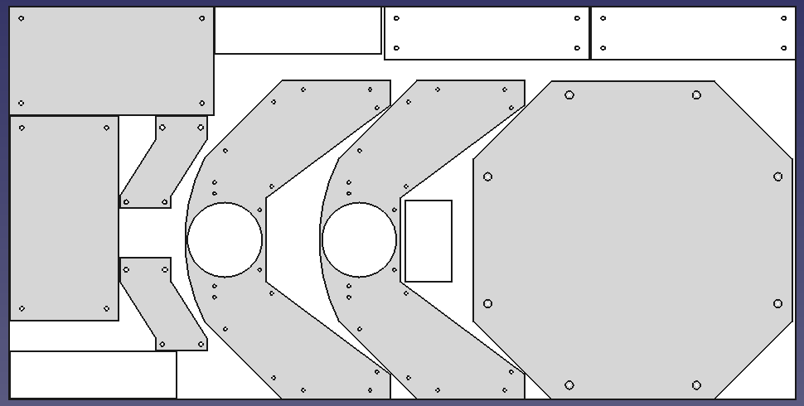
P0380b
P0350
P0350
P0355
P0375
P0375
P0325
P0355
P0380a
P0340
P0325
P0380b

Slide 13
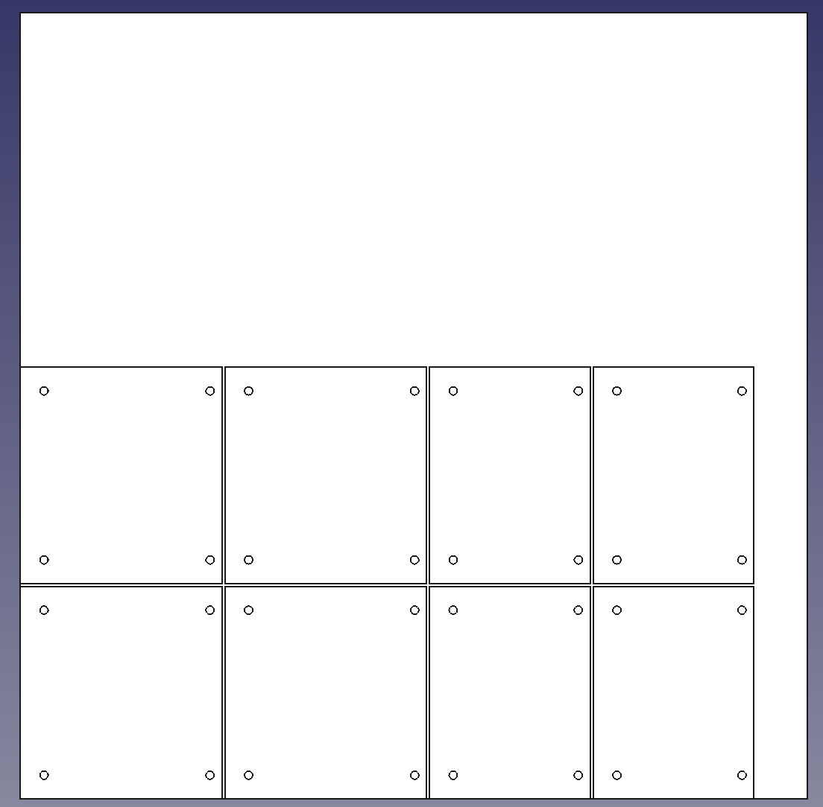
P0370
P0370
P0345
P0345
P0360
P0360
P0365
P0365

Slide 14
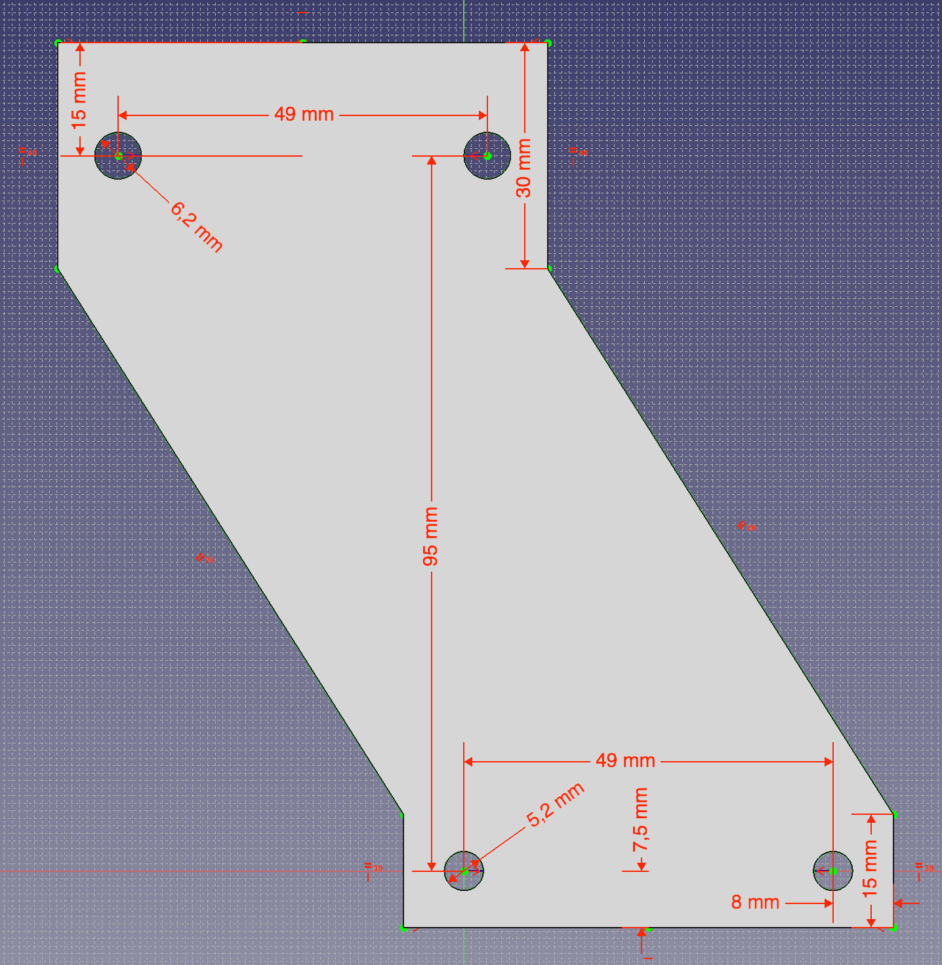
P0325 | Laser Support
Source: Plastic sheet 3mm
Units: 2
Assembly: Laser Set
Source Model: “Laser Supports” / Laser supports.FCStd

Slide 15
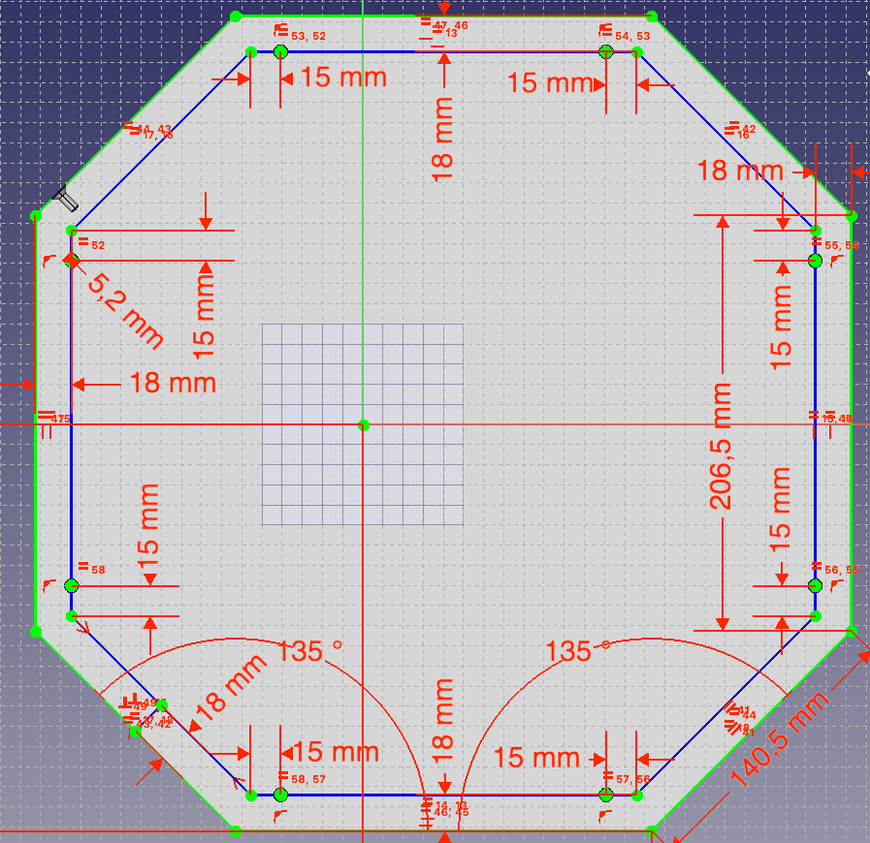
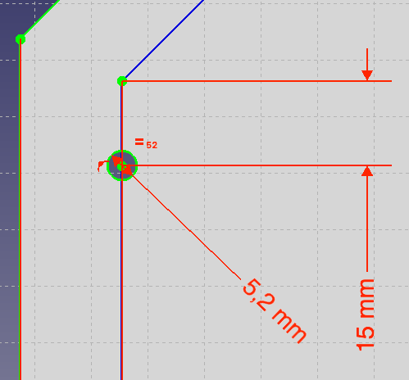
P0340 | PVC 3mm piece: Top cover
Source: Plastic sheet 3mm, 405x405mm
Color: Gray
Units: 1
Assembly: Top cover set
Source Model: “Top cover” / AGV-Parts v4.FCStd

Slide 16
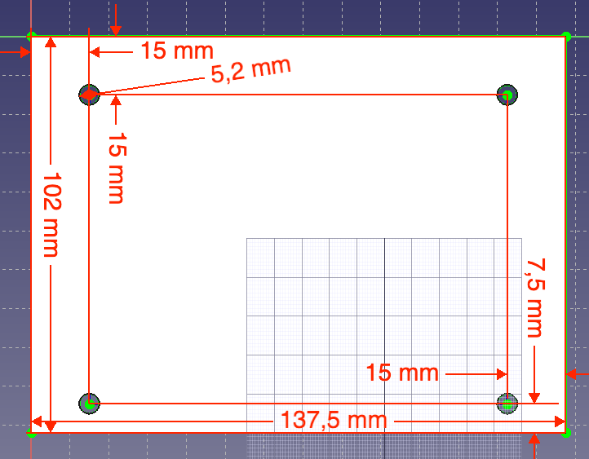
P0345 | PVC 3mm piece: Front Side-Bottom Cover
Source: Plastic sheet 3mm
Color: White
Units: 2
Assembly: Sides cover Set
Source Model: “Front Side-Bottom Cover” / AGV-Parts v4.FCStd

Slide 17
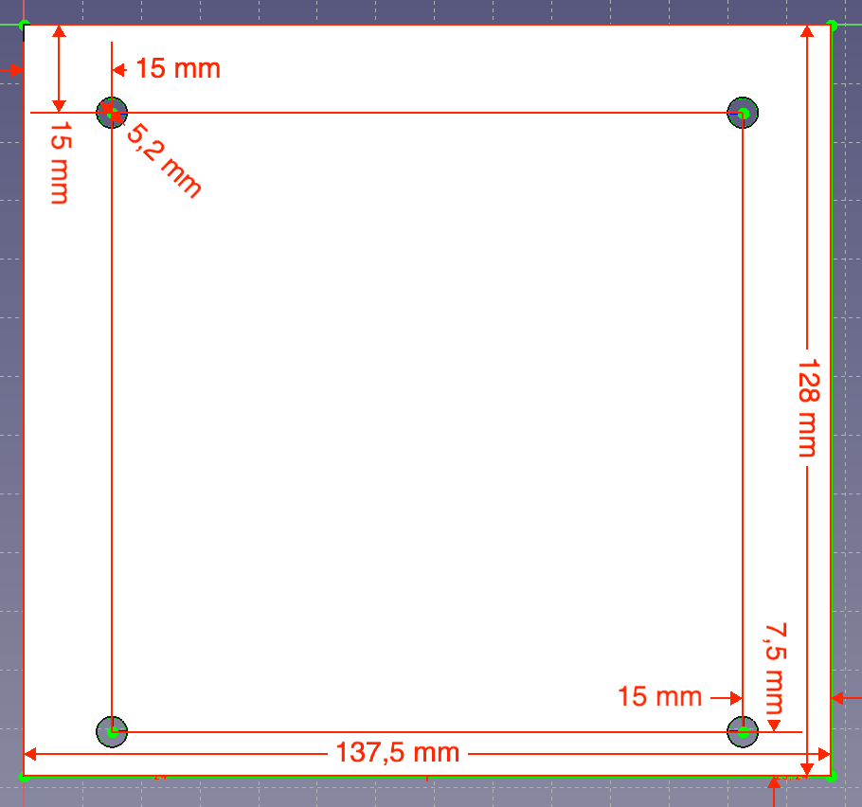
P0370 | PVC 3mm piece: Front Side-Top Cover
Source: Plastic sheet 3mm
Color: White
Units: 2
Assembly: Sides cover Set
Source Model: “Front Side-Top Cover” / AGV-Parts v4.FCStd

Slide 18
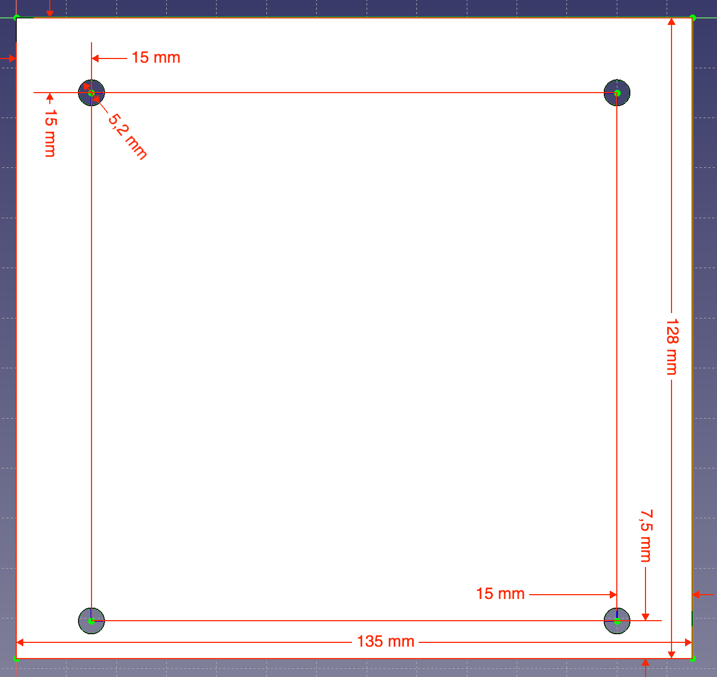
P0360 | PVC 3mm piece: Lateral-Top Cover
Source: Plastic sheet 3mm
Color: White
Units: 2
Assembly: Sides cover Set
Source Model: “Lateral-Top Cover” / AGV-Parts v4.FCStd

Slide 19
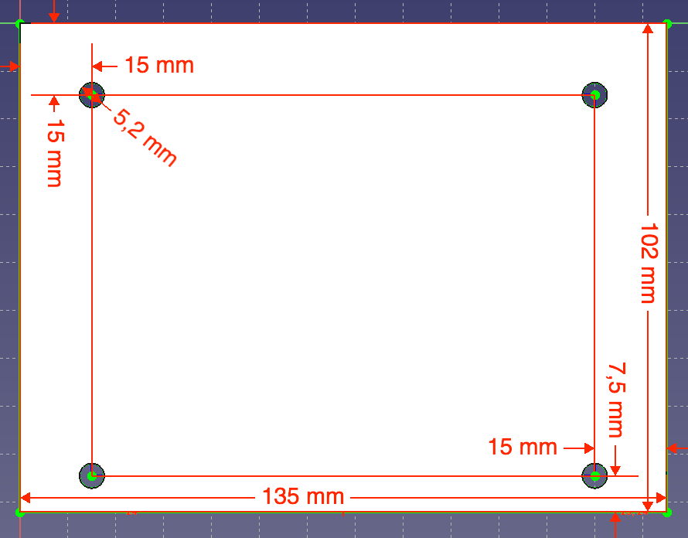
P0365 | PVC 3mm piece: Lateral-Bottom Cover
Source: Plastic sheet 3mm
Color: White
Units: 2
Assembly: Sides cover Set
Source Model: “Lateral-Bottom Cover” / AGV-Parts v4.FCStd

Slide 20
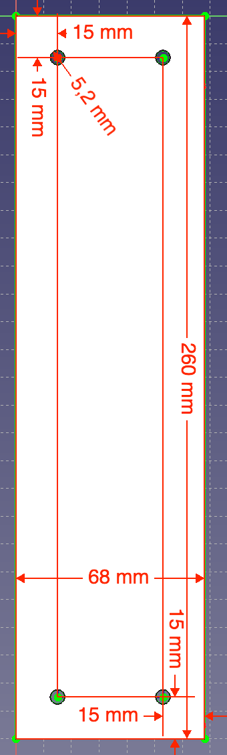
P0350 | PVC 3mm piece: Lateral-Back Cover
Source: Plastic sheet 3mm
Color: Gray
Units: 2
Assembly: Sides cover Set
Source Model: “Lateral-Back Cover” / AGV-Parts v4.FCStd

Slide 21
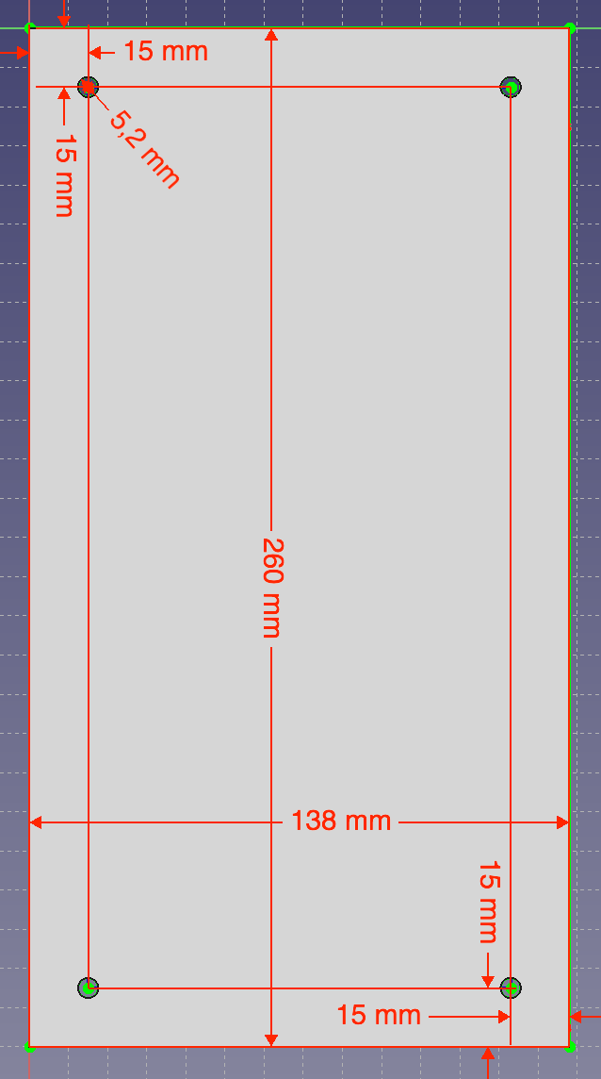
P0355 | PVC 3mm piece: Back Side Cover
Source: Plastic sheet 3mm
Color: Gray
Units: 2
Assembly: Sides cover Set
Source Model: “Back Side Cover” / AGV-Parts v4.FCStd

Slide 22
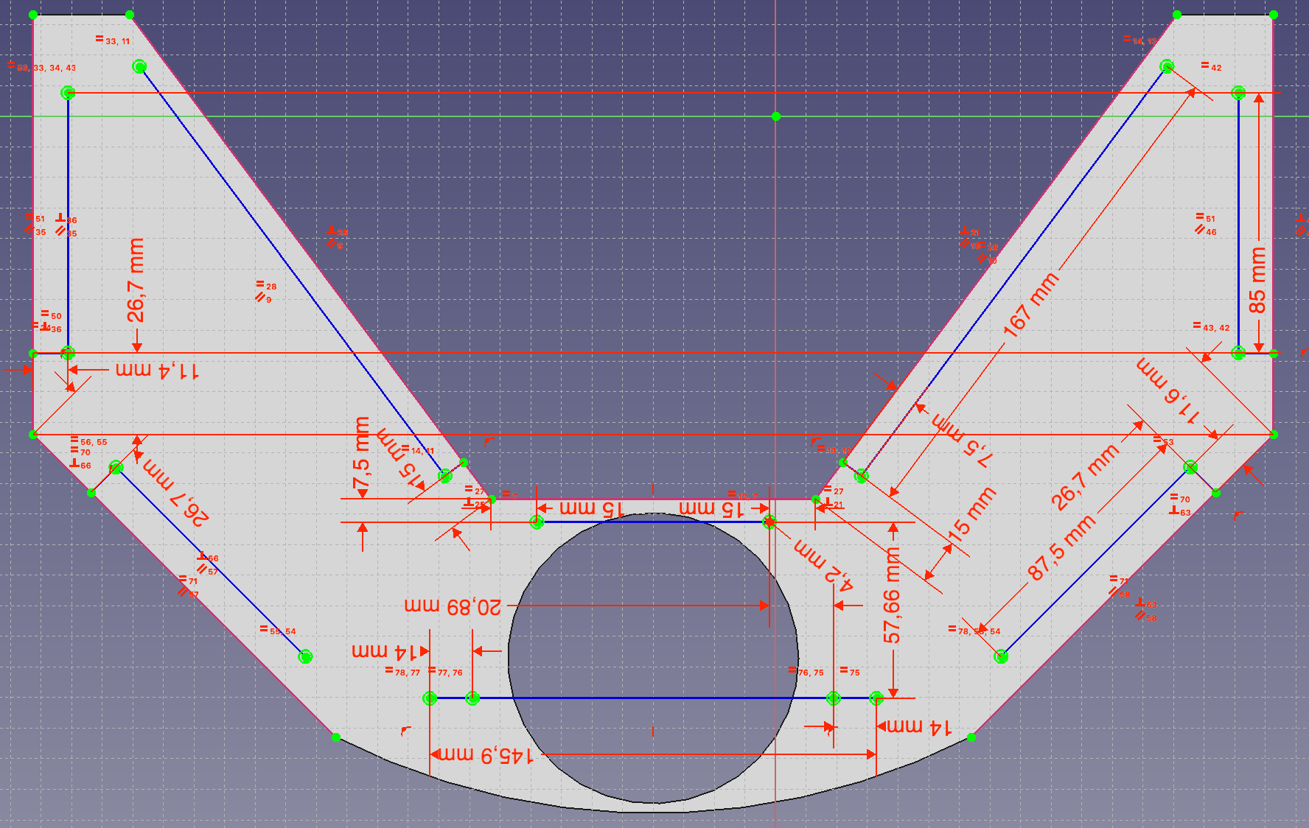
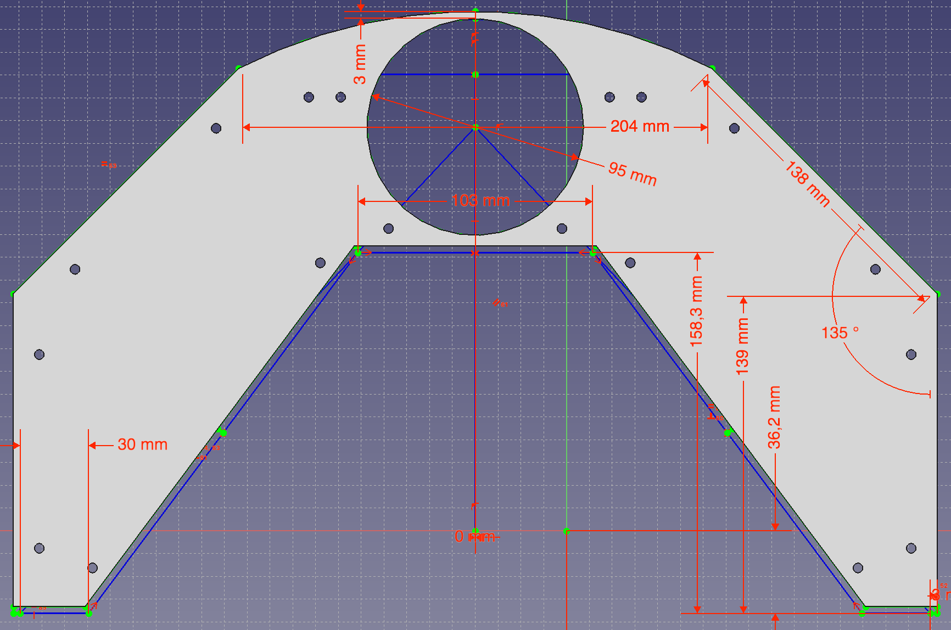
P0375 | PVC 3mm piece: laser beam area sheet
Cut all this part
145,9mm
Source: Plastic sheet 3mm, 261 x 405 mm
Color: Gray
Units: 1 + 1
Assembly: Laser beam area – Bottom / Laser beam area – Top
Source Model: “laser beam area sheet” / AGV-Parts v4.FCStd

Slide 23
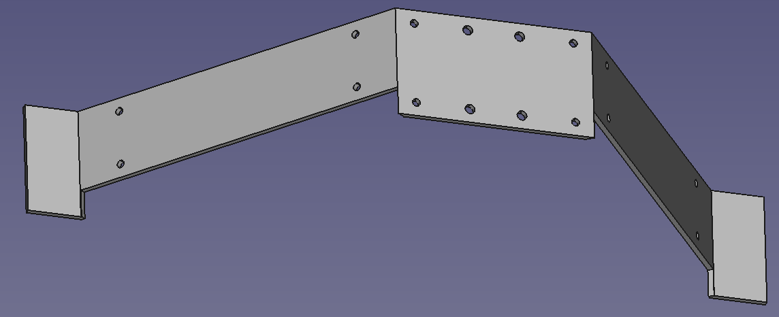
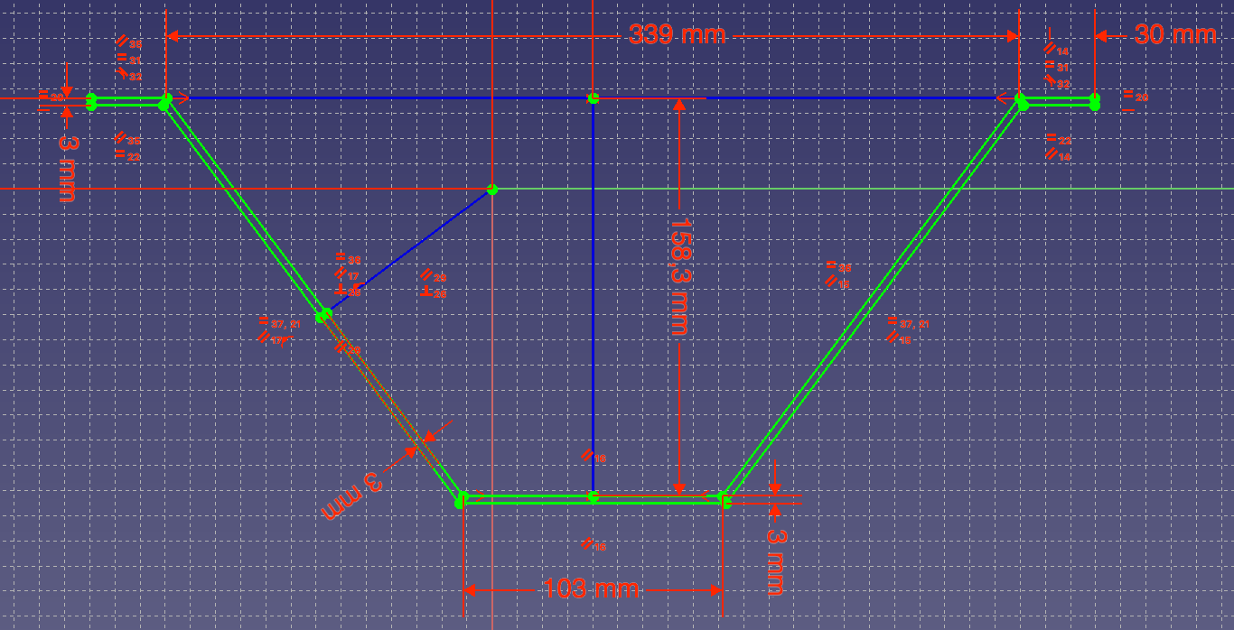
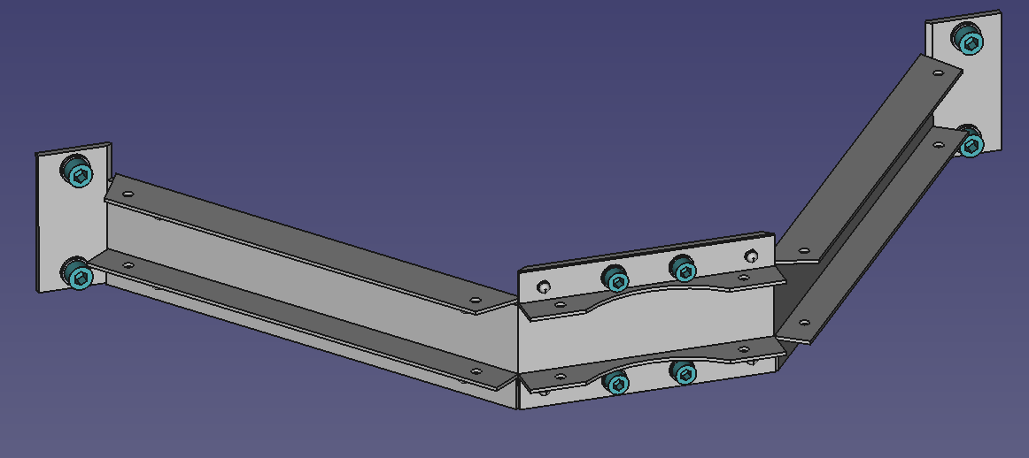
P0380 | PVC 3mm piece: Inside wall (Part 1)
Source: Plastic sheet 3mm
Color: Gray
Units: 1
Assembly: Sides cover Set
NOTES:
Could be done in one long piece (530x60), or split in three:
-Central part (from piece 103x60mm)
-2 Side parts (from 2 pieces 212x60mm)
Source Model: “Inside wall” / AGV-Parts v4.FCStd

Slide 24
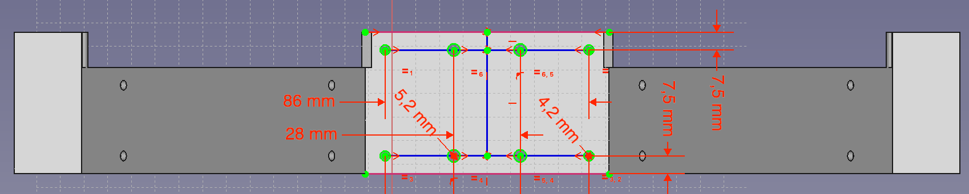
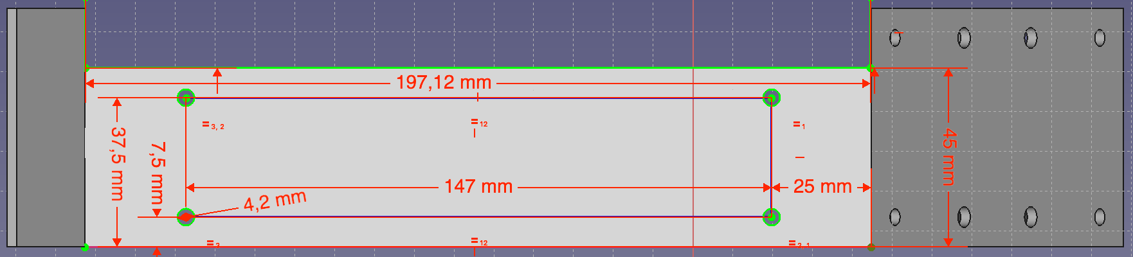
P0380 | PVC 3mm piece: Inside wall (Part 2)
30mm
7,5mm
15mm
60mm
7,5mm
Source Model: “Inside wall” / AGV-Parts v4.FCStd

Slide 25
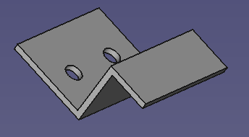
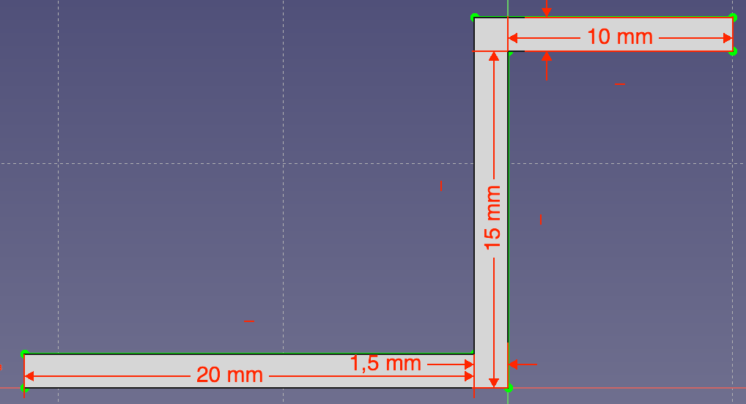
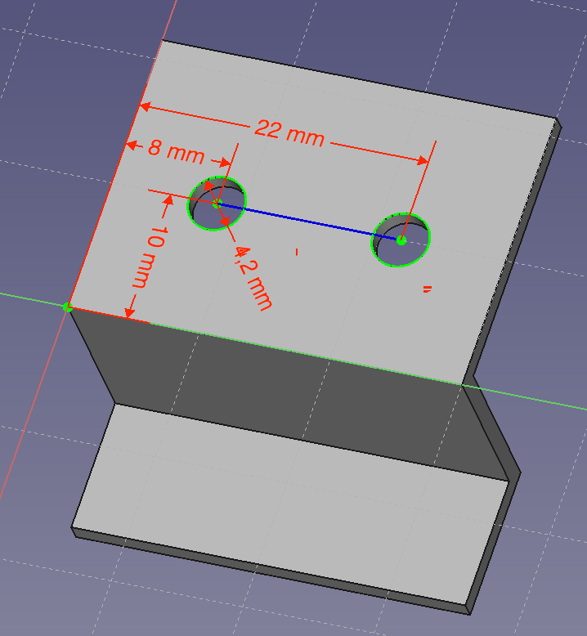
P0410 | Bracket front laser
Source: Aluminum sheet 30x1,5mm
Units: 2 + 2
Assembly: Laser beam area – Bottom / Laser beam area – Top
Source Model: “Bracket front laser” / AGV-Parts v4.FCStd

Slide 26


P0415 | Drive support
Source: Aluminum sheet 20x118x1,5mm
Units: 2
Assembly: Drives set
Install 2 M5 threaded rivets as shown in the picture. Each piece has the rivet in a different hole.
Source Model: “Drive support” / AGV-Parts v4.FCStd

Slide 27




P0425 | Bracket RFID
Source: Aluminum sheet 30x1,5mm
Units: 2
Assembly: RFID Set
NOTE: Install M4 threaded rivet as shown (note it is in different hole in each piece)
Source Model: “Aluminum Profile L shape type 006” / Aluminum Profiles.FCStd

Slide 28




P0290 | AGV_Soporte_motor_D
Units: 1, Printer file: AGV_Soporte_motor_D_v1.gcode
Material: PLA, Color: Gray, Weight: 44g, Printing time: 2h 33m
Assembly: Motors+Encoders
Source Model: “AGV_Soporte_motor_D” / AGV_Soporte_motor_D_v1.FCStd
P0295 | AGV_Soporte_motor_I
Units: 1, Printer file: AGV_Soporte_motor_I_v4.gcode
Material: PLA, Color: Gray, Weight: 44g, Printing time: 2h 33m
Assembly: Motors+Encoders
Source Model: “AGV_Soporte_motor_I” / AGV_Soporte_motor_I_v4.FCStd
P0300 | AGV_Rueda
Units: 2, Printer file: AGV_Rueda_v3.gcode
Material: PLA, Color: Gray, Weight: 44g, Printing time: 4h
Assembly: Motors+Encoders
Source Model: “AGV_Rueda” / AGV_Rueda_v3.FCStd
P0260 | Axel clamp
Units: 1 + 1, Printer file: Axel clamp x2.gcode (2 units at once)
Material: PLA, Color: Gray, Weight: 20g, Printing time: 1h 13m
Assembly: Balancing axel set, Clutch set
Source Model: “Axel clamp” / Axel clamp.FCStd

Slide 29



P0250 | 16mm axel corner clamp side a long
P0255 | 16mm axel corner clamp side b long
Units: 1a & 1b, Printer file: 16mm axel corner clamp side a_b long.gcode (both in one)
Material: PLA, Color: Gray, Weight: 21g, Printing time: 1h 24m
Assembly: Balancing axel set
Source Model: “16mm axel corner clamp side a long” / AGV_Clamp_eje_bal_v3.FCStd
Source Model: “16mm axel corner clamp side b long” / AGV_Clamp_eje_bal_v3.FCStd
P0265 | Clutch-cam A
P0270 | Clutch-cam B
Units: 1A & 1B, Printer file: Clutch Cam A and B.gcode (both in one)
Material: PLA, Color: Gray, Weight: 32g, Printing time: 1h 48m
Assembly: Clutch set
Source Model: “Clutch-cam A” / Clutch Cam A and B.FCStd
Source Model: “Clutch-cam B” / Clutch Cam A and B.FCStd
P0275 | Clutch axel cap
P0280 | Clutch axel clamp A
P0285 | Clutch axel clamp B
Units: 1 & 1A & 1B, Printer file: Clutch axel clamps and cap.gcode (all in one)
Material: PLA, Color: Gray, Weight: 14g, Printing time: 56m
Assembly: Clutch set
Source Model: “Clutch axel clamp A” / Clutch axel clamps.FCStd
Source Model: “Clutch axel clamp B” / Clutch axel clamps.FCStd
Source Model: “Clutch axel cup” / Clutch axel cup.FCStd

Slide 30




P0011 | 135 degree bracket
Units: 4 + 4, Printer file: 135deg bracket type 002 x8.gcode (x8 parts)
Material: PLA, Color: Gray, Weight: 63g, Printing time: 4h 18m
Assembly: Chassis Top, Chassis Bottom
Source Model: “135 degree bracket type 002” / 135 degree bracket.FCStd
P0016 | 135deg_small_braket M6 3holes
Units: 4 + 4, Printer file: ﻿135deg_small_braket M6 3holes type 002 x8.gcode (x8 parts)
Material: PLA, Color: Gray, Weight: 60g, Printing time: 4h 5m
Assembly: Chassis Top, Chassis Bottom
Source Model: “135deg_small_braket M6 3holes ” / 135degree_small_braket v2.FCStd
P0021 | 90 degree bracket
Units: 4 + 2, Printer file: ﻿30x30 corner bracket type 002 x6.gcode (x6 parts)
Material: PLA, Color: Gray, Weight: 48g, Printing time: 3h 26m
Assembly: Chassis Middle, Set limit motors Top
Source Model: “﻿30x30 corner bracket type 002” / AGV-Parts v4.FCStd
P0411 | Bracket front laser
Units: 2 + 2, Printer file: ﻿﻿Bracket Front Laser type 002 x4.gcode (x4 parts)
Material: PLA, Color: Gray, Weight: 11g, Printing time: 45m
Assembly: Laser beam area – Bottom / Laser beam area – Top
Source Model: “﻿Bracket Front Laser type 002” / AGV-Parts v4.FCStd

Slide 31



P0315 | Back top Cover
Units: 1, Printer file: Back top Cover v2.gcode
Material: PLA, Color: White, Weight: 107g, Printing time: 6h 33m
Assembly: Back Cover Set
Source Model: “Back top Cover v2” / AGV-Parts v4.FCStd
P0320 | Back bottom Cover
Units: 1, Printer file: Back bottom Cover.gcode
Material: PLA, Color: White, Weight: 92g, Printing time: 5h 23m
Assembly: Back Cover Set
Source Model: “Back bottom Cover” / AGV-Parts v4.FCStd
P0316 | RPiBox
Units: 2, Printer file: RPiBox.gcode
Material: PLA, Color: White, Weight: 49g, Printing time: 3h 12m
Assembly: Back Cover Set
Source Model: “RPiBox” / AGV-Parts v4.FCStd

Slide 32


P0305 | Front Top Cover
Units: 1, Printer file: Front Top Cover.gcode
Material: PLA, Color: White, Weight: 94g, Printing time: 5h
Assembly: Front Cover Set
Source Model: “Front Top Cover” / AGV-Parts v4.FCStd
P0310 | Front Bottom Cover
Units: 1, Printer file: Front Bottom Cover.gcode
Material: PLA, Color: White, Weight: 96g, Printing time: 4h 50m
Assembly: Front Cover Set
Source Model: “Front Bottom Cover” / AGV-Parts v4.FCStd

